Slide 1

Coffee Shop Sales Analysis (Q & A)
Prajwal Karnik

Slide 2



Q & A
Question 1
Question 2
Question 3
Question 4

Slide 3

Introduction
Coffee Shop dataset contains some of the features such as transaction id, transaction quantity, product prices and quantities, date of transaction.
I have downloaded this data from: (https://mavenanalytics.io/data-playground?page=3&pageSize=5)
On the following pages, I have given some recommendations to any businesses by providing solutions to likely asked Questions.

Slide 4


Question 1
What was the most profitable month for the business and how it varied by Hours?

Slide 5
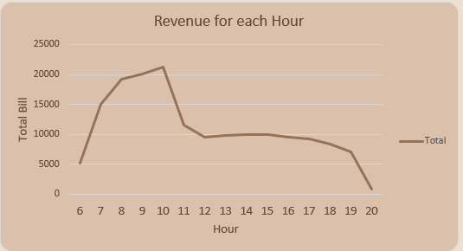
Answer
The most profitable month for the business was June crossing the revenue by whopping aprrox. $166,486.
The hourly graph for the month June look like this:

Slide 6
Question 2
What was the most chosen Store location preferred by customers and what is the pattern?

Slide 7
Answer
The most chose Store location preferred by the customers is based by before noon and after noon.
The pattern I observed suggests that before noon customers preferred Lower Manhattan and after noon they preferred Hell’s kitchen.
It is observed through all months.
Suggestion:
The business should decide what would be the best possible way to attract customers.
It should consider the parameters such as online marketing, improvement of interiors, customer’s preference to particular product category and their beaviour.

Slide 8
Question 3
What was the product type mostly liked by the customers and what was their behavior?

Slide 9
Answer
At the start of the year that is in January, customers preferred Brewed Chai tea.
But in February, April and May customers gave their preference to Hot chocolates.
In March and June, product type Barista Espresso is mostly favoured.
Suggestion:
Business should do a proper marketing in these months to maintain and increase their customers and profit.

Slide 10
Question 4
What are the top product categories customers preferred over all months?

Slide 11
Answer
Over all months product category Coffee is favoured followed by Tea.
Another insight I would like to add here is, these product category maintained their customer’s preference over all day and night same.
Suggestion:
Business can neglect the poorly contributed product categories and should focus on Tea and Coffee products.

Slide 12


The way to get started is to quit talking and begin doing.
Walt Disney
20XX
12

Slide 13

Summary
In this Excel Coffee Shop data analysis project, I have created Pivot tables, built formulas and visualised this into actionable insight using Slicers by adding graphs and plots.
I also filtered the data using Power Queries in Excel.
This project aims to give recommendations to any client who is interested in Coffee and other brewed items. It will give actionable insight to him.

Slide 14

Thank you
Prajwal Karnik
prajwalkarnik@gmail.com
https://github.com/prajwalkarnik08/Coffe_Shop_Sales_Analysis

